Slide 1
The Dynamic Homotopy and
the Path Follower
Based on A. Lima-Silva and F. D. Freitas, "Exploring a Dynamic Homotopy Technique to Enhance the Convergence of Classical Power Flow Iterative Solvers in Ill-Conditioned Power System Models", Energies 17(18):4642, 2024
Presented by Apurbo · Team: 2105039, 2105040, 2105057, 2105058, 2105060
CSE 402 Numerical Analysis Sessional
Notes:
We implemented the paper from scratch in Python, reproduced its results, and then tested changes to the method. First the paper, then our implementation and reproduction, then the improvements.

Slide 2
My part of the project
1
The homotopy
2
Paper results
G(x, t), the ODE, and the FE, RK2 and BE integrators
Figures 1, 2 and 4, and the first-step study of Section 4.2.1
3
solve() and the corrector
4
Spectrum of J
one path follower with switches; a Newton corrector
power method and inverse iteration: why the shift works
Apurbo's part · Lima-Silva & Freitas (2024): reproduction and improvements
2
Notes:
I implemented the core of the paper, the dynamic homotopy, and the framework that lets every improvement be switched on and off.

Slide 3
The fixed-point homotopy
t = 0: root is x₀
smooth path x(t)
t = 1: g(x) = 0
Root finding becomes an initial value problem. Each slope costs one LU.
Apurbo's part · Lima-Silva & Freitas (2024): reproduction and improvements
3
Notes:
Section 3.1 of the paper, equations 15, 23 and 24. Differentiating G(x(t), t) = 0 with the chain rule gives the ODE. The integrators FE, BE and RK2 (equations 16, 19, 20-21) each take a few big steps along it, and NR or FDXB finishes from x(1).

Slide 4
The first step is a shifted Newton step
forward Euler at t = 0 inverts K·I: it steps by −50 g(x₀), blind to the network
backward Euler inverts Δt₀ J + (1 − Δt₀) K I: a Newton step with δ on the diagonal
BE and the linearised step (eqs. 26, 27) give the same point; a unit test checks this
the shift δ lifts the tiny eigenvalues of J
Apurbo's part · Lima-Silva & Freitas (2024): reproduction and improvements
4
Notes:
Divide the BE step by dt0 and it is exactly x0 - (J + (1 - dt0) K/dt0 I)^-1 g(x0). This is the key fact behind the whole method: on the ill-conditioned grids J is nearly singular, and delta keeps the Newton step from exploding.

Slide 5
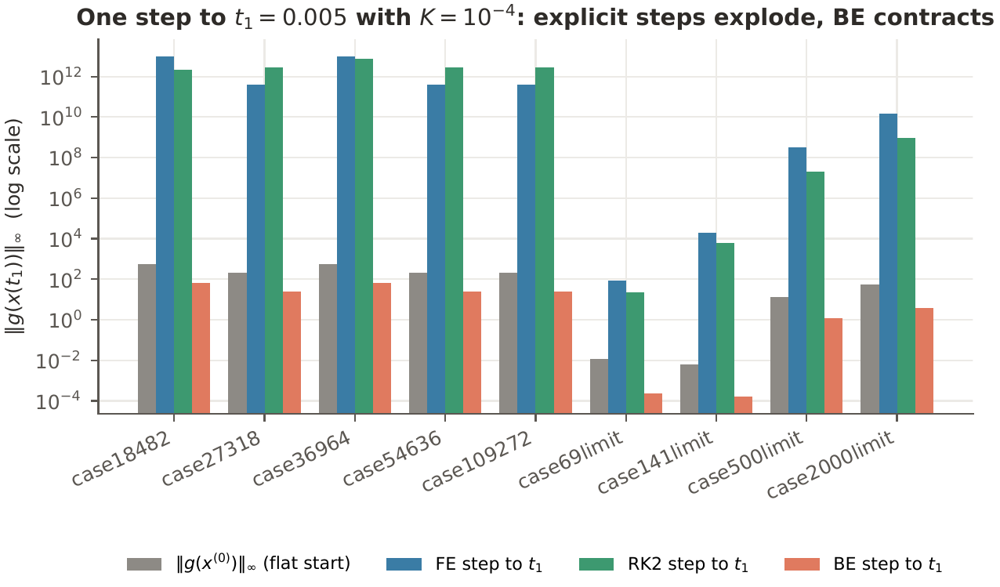
Section 4.2.1: the first step, reproduced
case18482, ‖g‖ after one step
533 → 10¹³
forward Euler
533 → 65
backward Euler
Apurbo's part · Lima-Silva & Freitas (2024): reproduction and improvements
5
Notes:
For every case of the paper, the flat-start mismatch next to the mismatch after one FE, RK2 or BE step to t1 = 0.005. Explicit steps blow up to about 1e12 on the large grids (9.7e12 on case18482); backward Euler brings it down to 65 and 25. This is why the paper always takes the first step with BE.

Slide 6
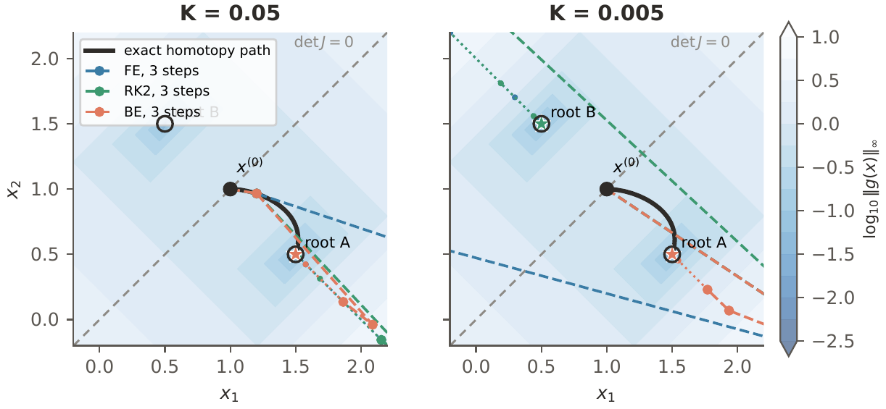
Figures 1 and 2: the 2×2 example
Newton alone: 11 and 10 iterations for ε = 0.005 and 0.01, exactly as in the paper. The paper's ε = 0.05 curve does not fit its own equations.
Apurbo's part · Lima-Silva & Freitas (2024): reproduction and improvements
6
Notes:
Section 3.3's example, drawn in the (x1, x2) plane over a map of the mismatch for K = 0.05 and 0.005: the exact homotopy path, the three-step FE, RK2 and BE paths and the Newton iterations after them, the singular line of the Jacobian and the two roots. For eps = 0.05, one NR step from (1, 0.95) gives a mismatch near 100, log10 about 2, but the paper's curve starts near 3.

Slide 7
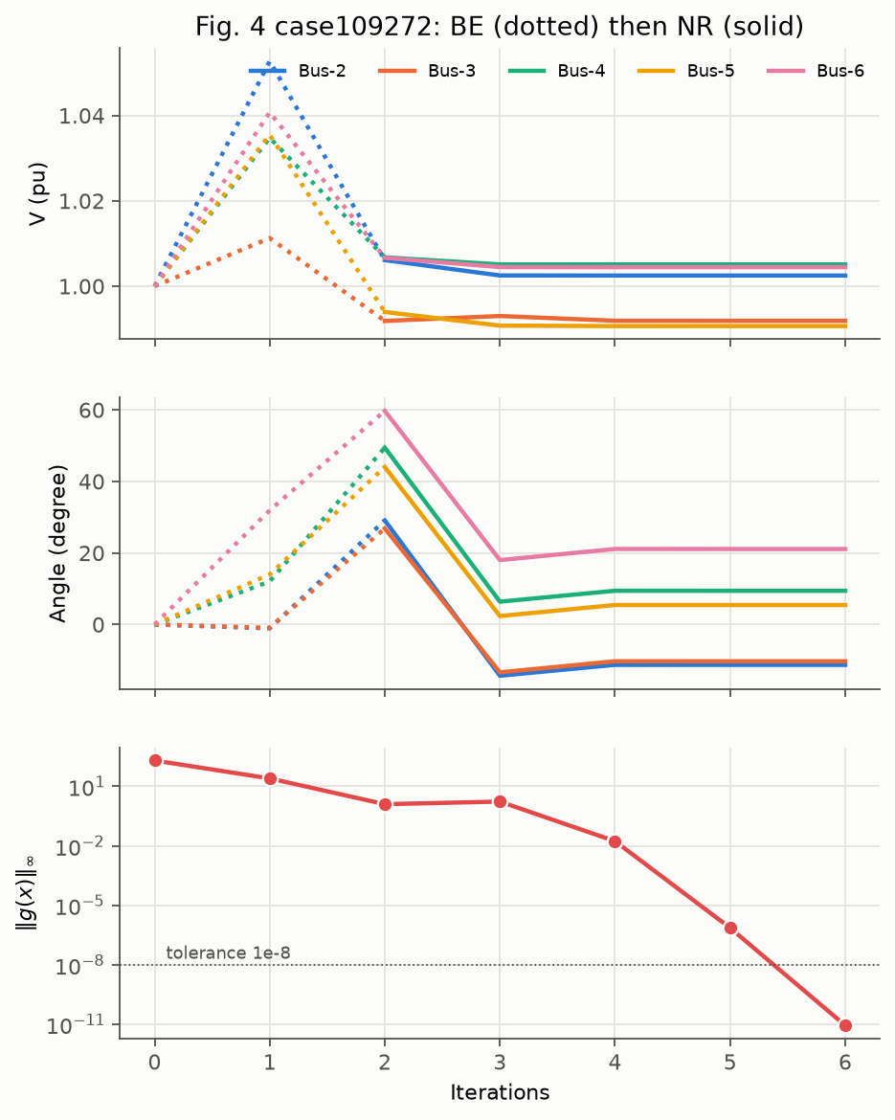
Figure 4: the largest grid
2 path points + 4 NR
iterations on case109272 (185,807 unknowns), as in the paper
1.0045 pu, 21.1°
final voltage at bus 6, the same as the paper
Apurbo's part · Lima-Silva & Freitas (2024): reproduction and improvements
7
Notes:
Voltages of buses 2 to 6 along the two-point BE path and then NR. The angles overshoot to about 60 degrees at t = 1, which is harmless: the point is already inside Newton's region of convergence. Mismatch 201, 25, 1.26 along the path, then 1.7, 1.7e-2, 7.3e-7, 8.8e-12.

Slide 8
One solver with switches: solve()
flat start
path: step rule
corrector?
adaptive or Richardson?
NR / FDXB (multiplier?)
Switch | Options | Owner
step | BE, FE, RK2, RK4, BE-chord | Sizan
corrector, adaptive | on / off | Apurbo
multiplier | on / off | Hasbi
richardson | on / off | Sadman
All off
= the paper's method, checked by a test
Apurbo's part · Lima-Silva & Freitas (2024): reproduction and improvements
8
Notes:
improvements/solve.py holds Options and solve(). Every team member's change plugs in as a switch, so they can be tested alone or combined in the study. With everything off it reproduces the paper's result exactly.

Slide 9
Improvement: a Newton corrector
predictor: the BE step gives x̃ near the path; corrector: one Newton step back onto it
152
14 → 2
+0.4 LU
of 170 runs solved (paper 127), none lost
wrong roots
per run (8.43 vs 8.04)
Apurbo's part · Lima-Silva & Freitas (2024): reproduction and improvements
9
Notes:
The standard predictor-corrector of continuation methods, at a fixed new time. It is the most useful change of the whole study, and it makes the result almost independent of dt0.

Slide 10
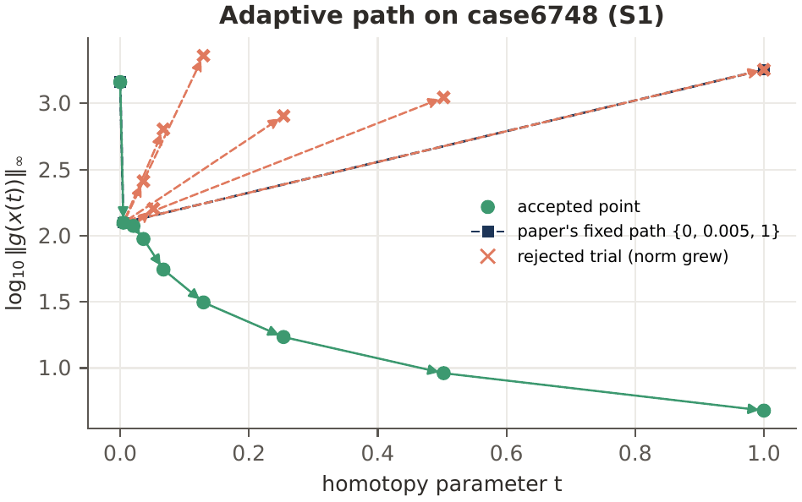
Adaptive steps: a smaller gain
try to jump straight to t = 1
halve the step while ‖g‖ grows
132
of 170 solved (paper 127)
Apurbo's part · Lima-Silva & Freitas (2024): reproduction and improvements
10
Notes:
Every step the adaptive rule tries on case6748 at the paper's setting, accepted and rejected, next to the paper's fixed path. Rejected steps still cost LUs, so on its own it helps little.

Slide 11
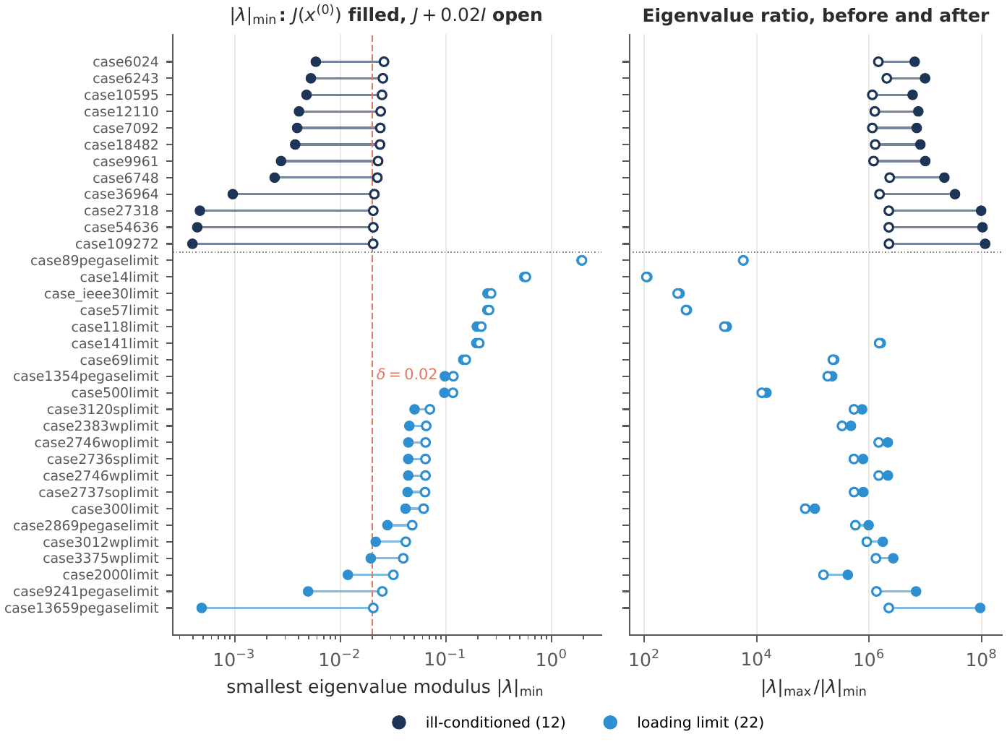
Why the shift works: the spectrum of J
|λ|max: power method
|λ|min: inverse iteration (one LU)
eigenvalue ratio, case109272
1.2×10⁸ → 2×10⁶
J → J + 0.02 I
inverse iteration matches ARPACK on 33 of 34 grids
Apurbo's part · Lima-Silva & Freitas (2024): reproduction and improvements
11
Notes:
Shifted inverse iteration gives the smallest eigenvalue of J + delta I, the matrix of the first step. The shift lowers the ratio on the ill-conditioned grids but hardly changes most limit cases, whose smallest eigenvalue is already larger than 0.02; there the method behaves like plain NR. The power method is up to 19% off on grids made of copies of one network, where the largest eigenvalues cluster.

Slide 12
Summary
Implemented the homotopy, the ODE and the FE, RK2 and BE integrators
Reproduced Figures 1, 2 and 4 and Section 4.2.1
The first BE step is a Newton step on J + δI: that is why the method works
Corrector: 152 of 170 solved, wrong roots from 14 to 2
Thank you. Questions?
Apurbo's part · Lima-Silva & Freitas (2024): reproduction and improvements
12

